Slide 1

Department Of Mechanical Engineering Vasavi College Of Engineering
Mini Project
Batch.no:2
Title :- 3D CAD Modelling of a Farmer Assistant Robot
Team Details:-
1602-23-736-005 Amgoth Thavu
1602-23-736-013 Haritha CH
1602-23-736-020 Manoj M
Project Guide:-
K .Veladri
Associate Professor

Slide 2
Table of contents:-
Problem Statement ………………………………..……..3
Need for a robot ……………………………………...….4
Objective of the project……………………………….…5
Literature review……………………………………........6 - 7
Design and Components …..…………………………….8 - 21
3D Model………………………………………………...22 - 24
Methodology……………………………………………..25 - 26
Future Scope……………………………………………..27
Results ……………………………………………..........28
Conclusion………………………………………….........29
References……………………………………………….30

Slide 3
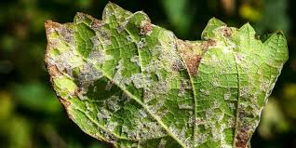
Problem Statement:-
Farmers struggle to detect plant diseases early.
Checking each plant manually takes a lot of time and effort.
Early symptoms on leaves are small and easy to miss.
Delayed detection leads to big crop losses.
Many farmers don’t have quick access to experts for diagnosis.
Wrong or late treatment increases cost and reduces yield.

Slide 4
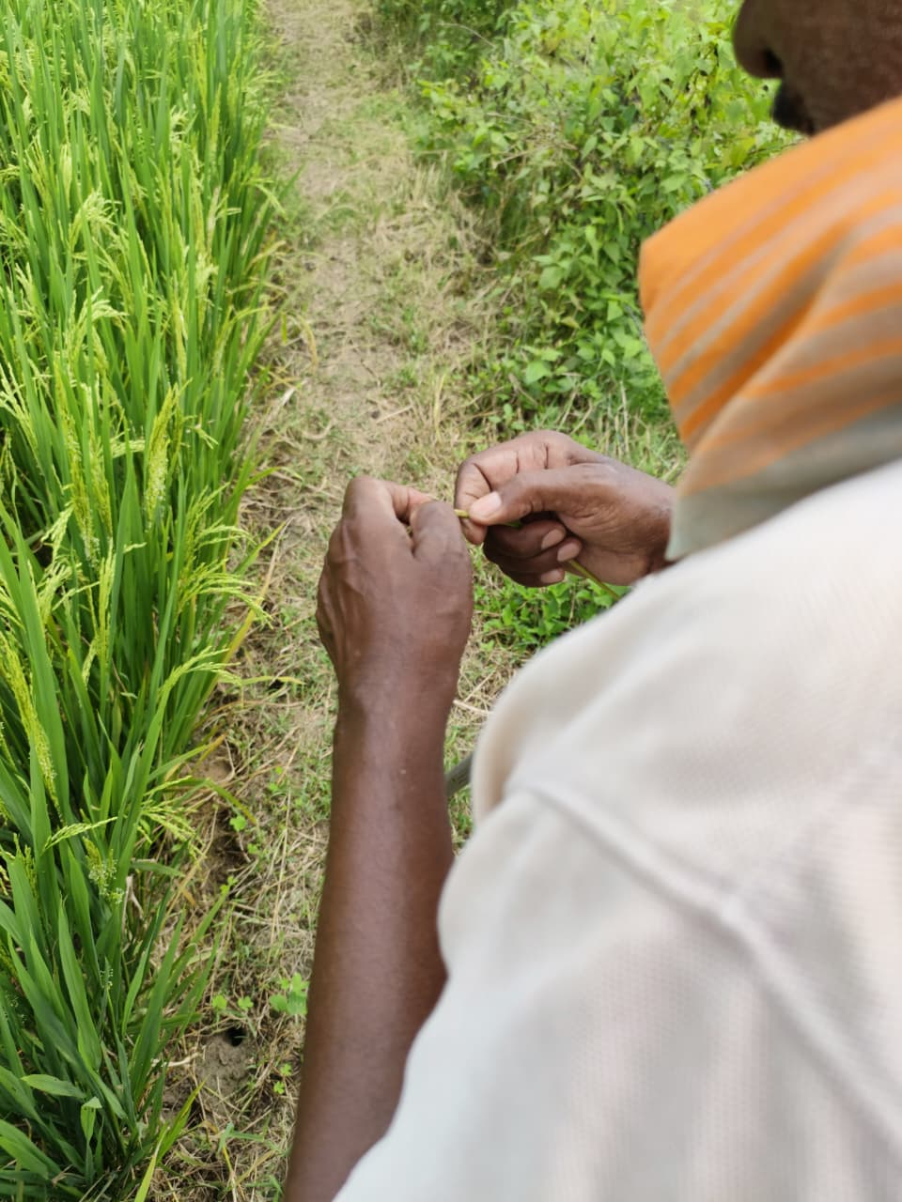
Need for a Robot:-
Farmers cannot check every plant manually in large fields.
Robots give faster and more accurate disease detection.
Early detection helps prevent the spread of infection.
Robots reduce the farmer’s workload and save time.
They help farmers make better decisions for treatment.
Robots reduce unnecessary use of pesticides by detecting the exact problem.
They improve crop health and increase overall yield.
Robots can work in harsh weather or sunlight where humans may struggle.
Technology brings precision farming and reduces losses.

Slide 5
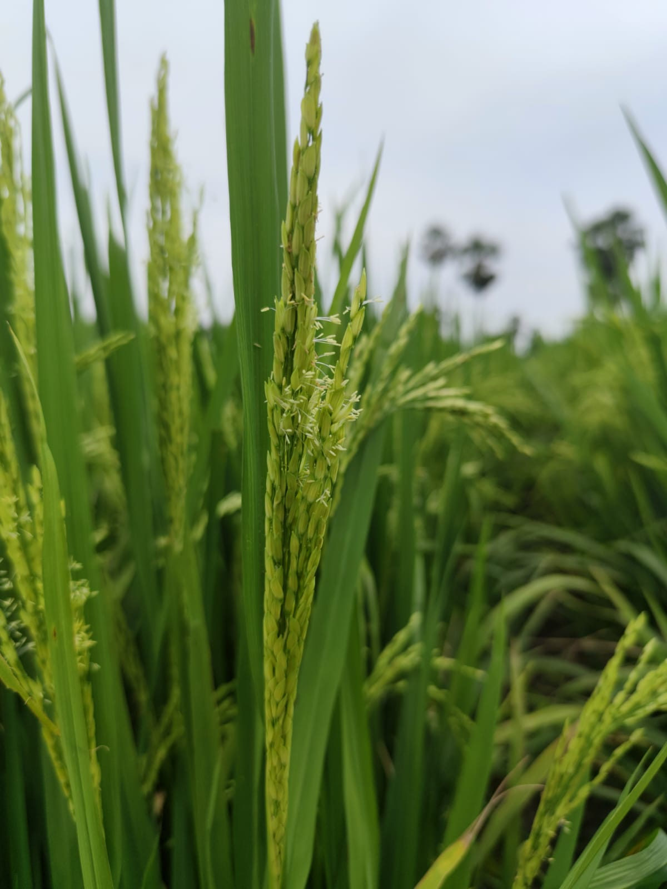
Objective of the Project:-
Design a robotic assistant that can automatically monitor plants and detect early signs of leaf disease.
Capture clear images of plant leaves using an onboard camera and analyze them using a detection algorithm.
Provide quick alerts to farmers so they can take timely action and prevent disease spread.
Reduce manual inspection, save time and labor, and support precision farming.
Build a field-friendly robot that can move easily and work effectively in outdoor conditions.

Slide 6
Literature Review:-
Fast and Accurate Detection and Classification of Plant Diseases- H. Al-Hiary, S. Bani-Ahmad, M. Reyalat, M. Braik and Z. ALRahamneh | The study introduces an improved system for automatically detecting and classifying plant leaf diseases. It removes unnecessary green and boundary pixels to make the process faster and more accurate. The method works well, reaching 83–94% accuracy and running 20% faster than the previous approach.
Detection and Classification of Plant Leaf Diseases by using Deep Learning Algorithm-M. Akila , P. Deepan ,Arasu Engineering College, Kumbakonam, India | This paper uses deep-learning methods to detect diseases on plant leaves from images. Three detection models—Faster R-CNN, R-FCN, and SSD—were tested, and SSD was chosen for the system. The method can accurately identify different leaf diseases, even in complex plant environments, helping farmers detect problems early.
Design and development of an automated and Non–contact sensing system for continuous Monitoring of plant health and growth -M. Kacira, P. P. Ling | A computer-controlled system was created to continuously monitor plant health and growth. It used sensors to track temperature, moisture, and plant changes, while a motorized turntable helped collect data evenly. The system also controlled irrigation automatically, providing accurate and consistent plant monitoring.

Slide 7
Literature Review:-
Design of a Plant Health Monitoring System for Enhancing Food Safety of Space Crop Production Systems- Oscar Monje, Matthew R. Nugent. | A new imaging system was created to detect plant stress early in space without needing crew involvement. It uses hyperspectral and fluorescence sensors with special LED lights to capture detailed plant images. These images help spot signs of problems—like drought or nutrient issues—much earlier than normal photos. Future work will improve the system and find the best indicators for different plant stresses.
Prediction and Analysis of Paddy Crops Disease in Artificial Intelligence Techniques- Tanmayee Tushar Parbat Rohan Benhal | Paddy crops are easily affected by diseases caused by bacteria, fungi, viruses, and insects, which can greatly reduce yield. In the past, farmers checked diseases manually, but this was slow and often inaccurate. Today, image processing and machine learning help quickly identify and classify plant diseases and even detect weeds, making crop management easier and more effective.
AI-IoT based smart agriculture pivot for plant diseases detection and treatment- Amin S. Ibrahim1, Saeed Mohsen | Modern farming struggles with water shortages, plant diseases, and pests. AI and IoT technologies help solve these problems by enabling smarter and more efficient farming. This paper presents a new AI-IoT pivot system that can detect and treat plant diseases better than drones or robots. Using a large dataset of leaf images, the ResNet50 model achieved very high accuracy in identifying 11 types of plant diseases.

Slide 8
Components of the Robot:-
Rear Hub left hand side
Rear hub right hand side
Trailing Arm
Gear
Arm top
Arm bottom
Front plate
Front Brace
Top brace
Motor Housing
Chassis
Track wheel
Solar panel

Slide 9
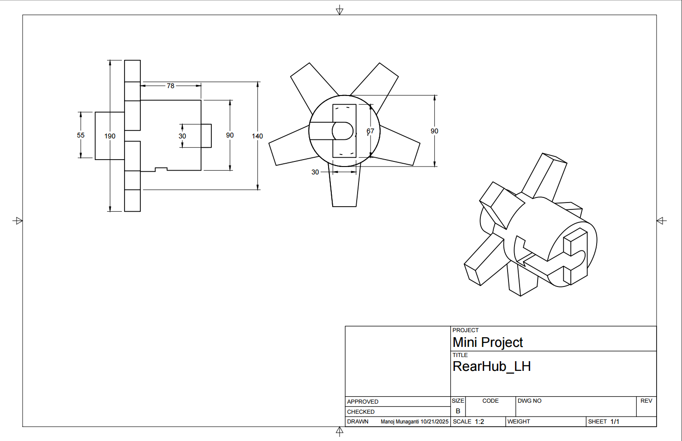
Rear Hub left hand side:- The left side of the rear hub helps hold the axle in position and keeps the wheel centered in the frame.

Slide 10
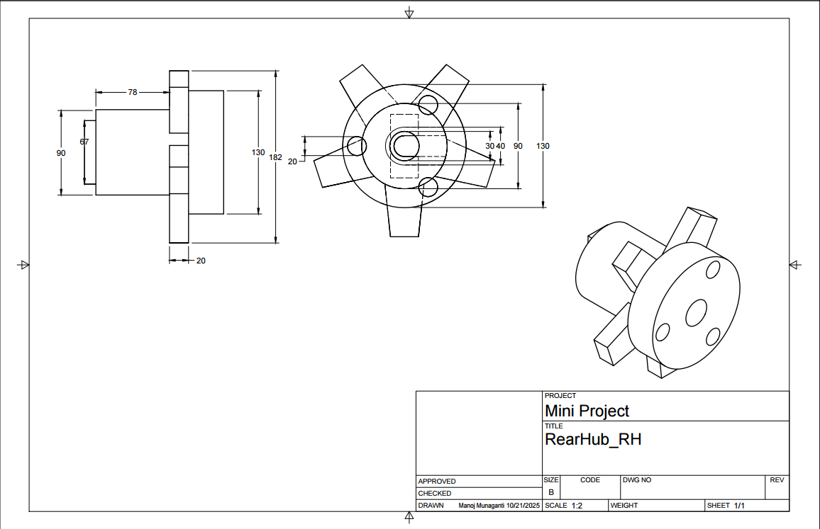
Rear hub right hand side:-The right side of the rear hub helps hold the axle in position and keeps the wheel centered in the frame.

Slide 11
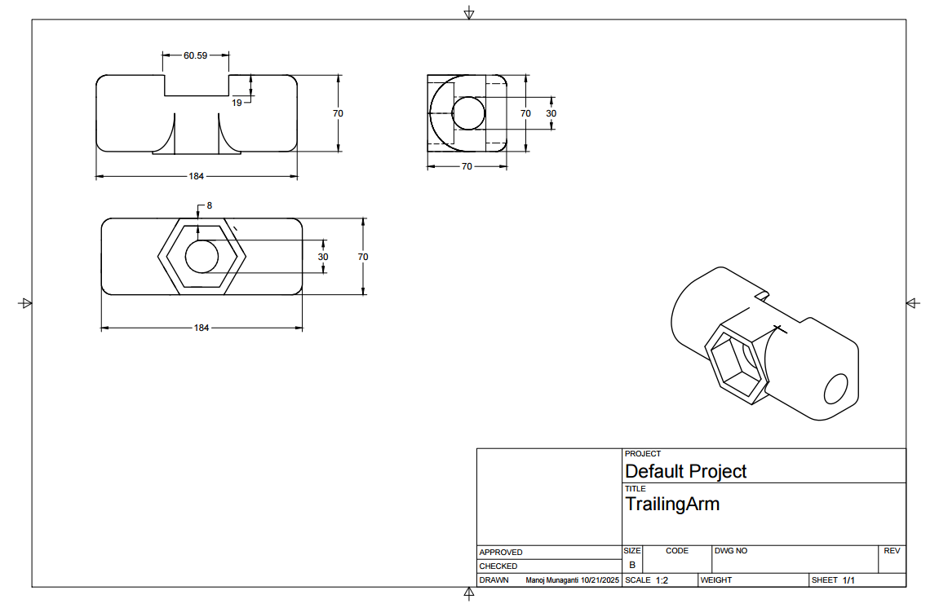
Trailing Arm :- Connects both Rear hub right hand and left-hand side , transmitting motion and load.

Slide 12
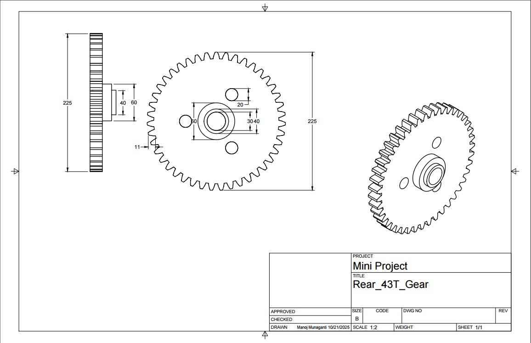
Gear :- The gear receives rotation motion and turns the rear wheel.

Slide 13
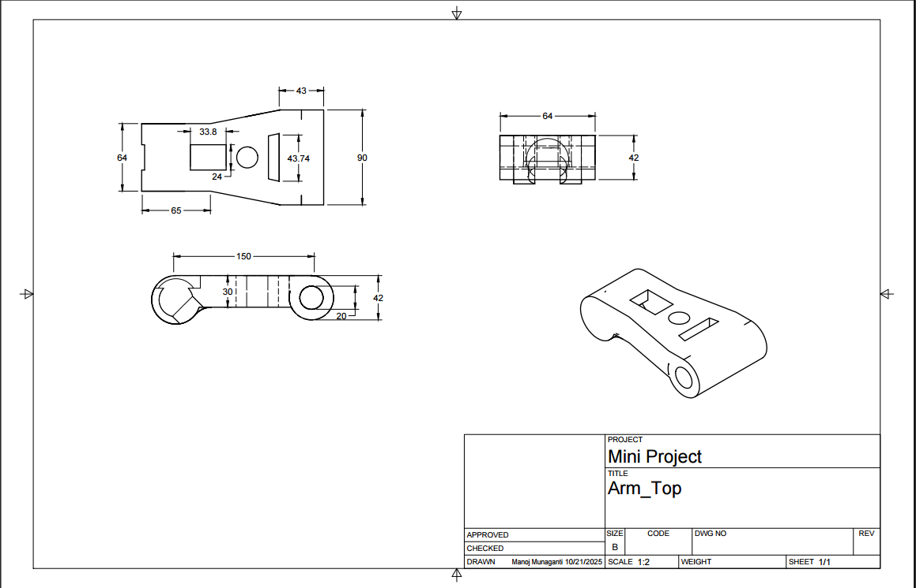
Arm top : The arm top connects to front plate which creates the suspension for the front portions of rover which is the function of the arm top.

Slide 14
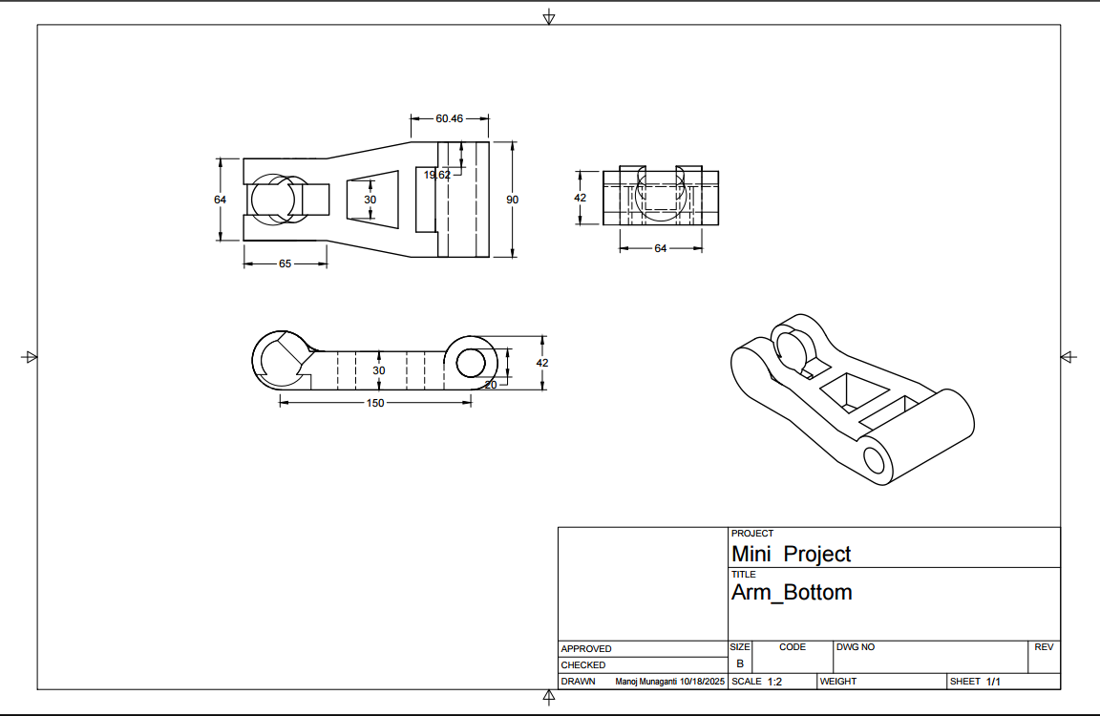
Arm bottom : The arm bottom connects to front plate which creates the suspension for the front portions of rover.

Slide 15
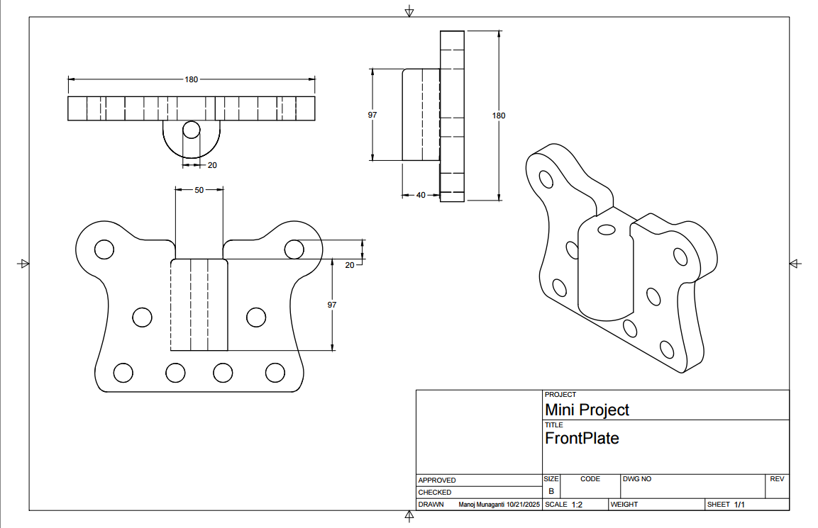
Front plate : The front plate holds both the arms of top and bottom , left and right

Slide 16
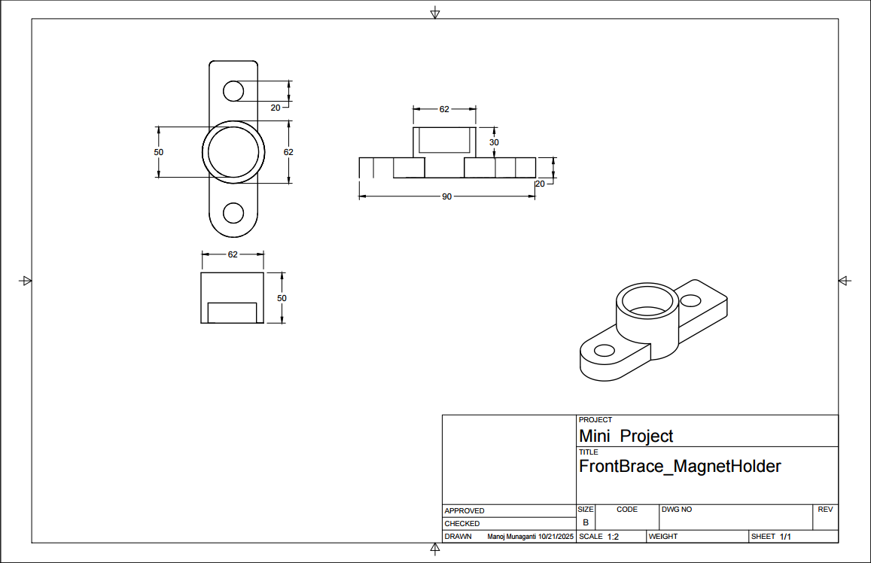
Front Brace : The front Brace holds the two front plates as per required suspension

Slide 17
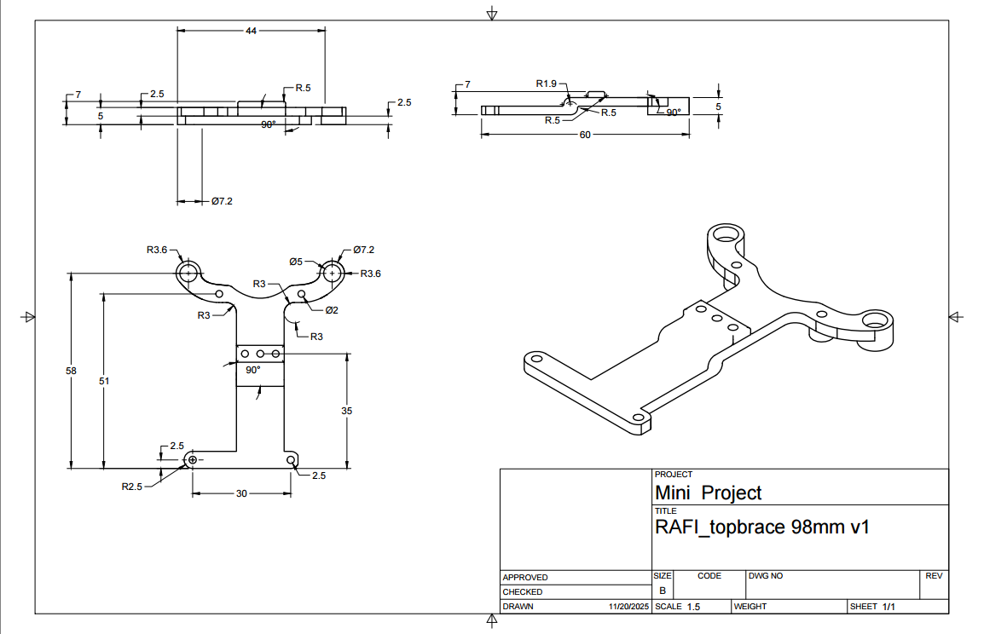
Top brace : It’s function is to cover the components which are inside the chassis .

Slide 18
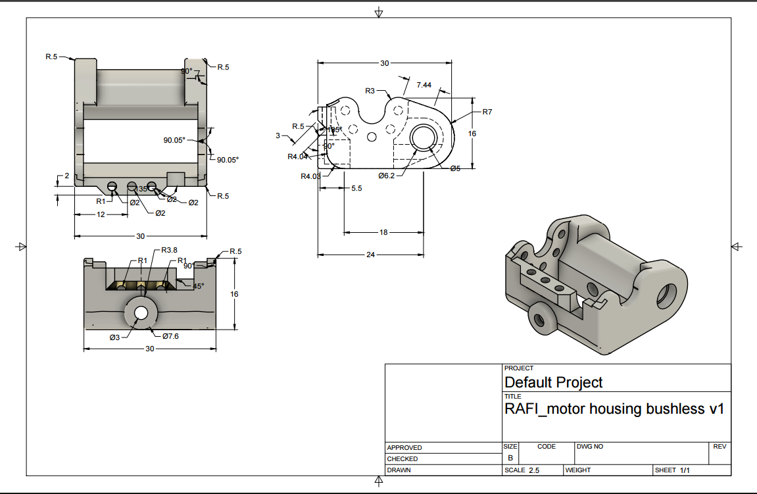
Motor Housing : The motor housing name itself says that it protects motor modules , it connects to the gear present in left hand side .

Slide 19
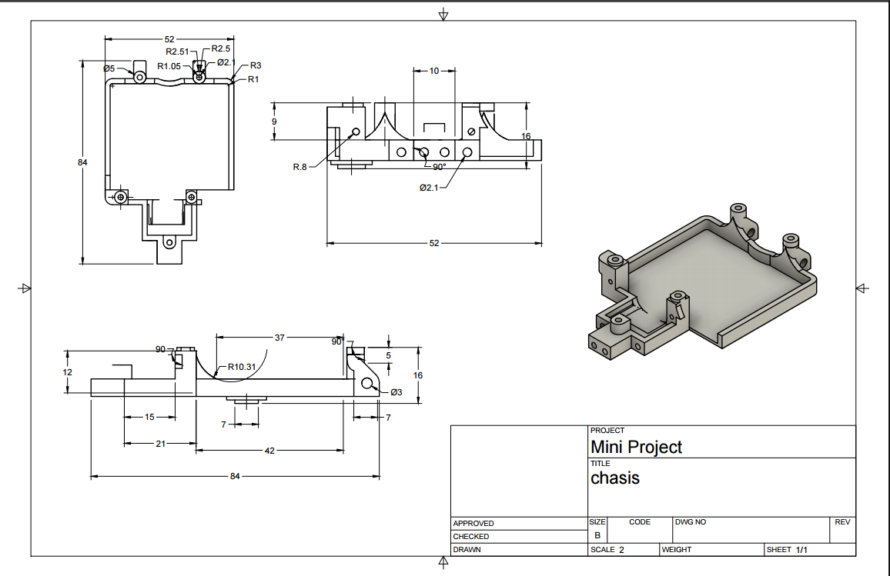
Chassis:- It holds all the components mounted on it. It acts as a connection between front and back wheels.

Slide 20
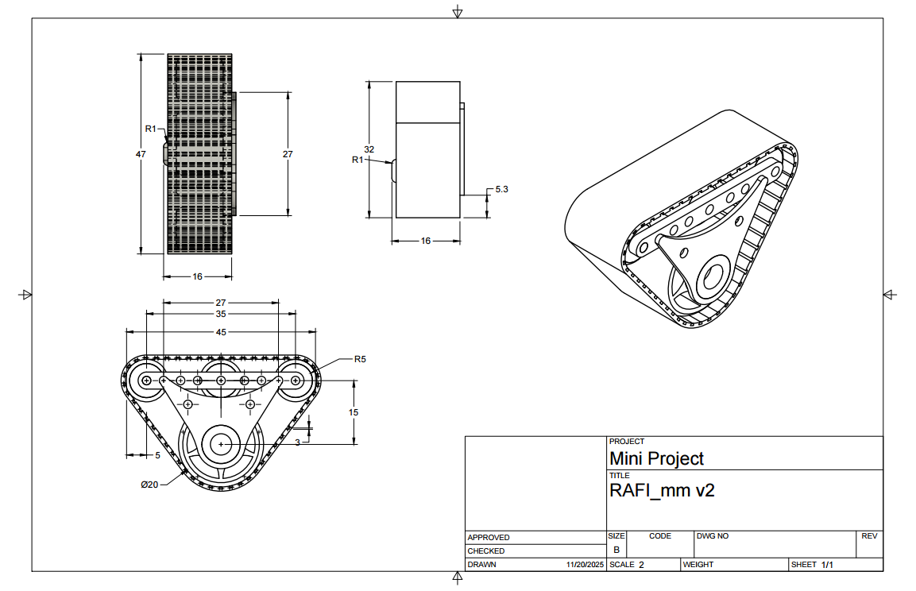
Track wheel : Its function is to keep the track in place and let it move smoothly and also to distribute pressure and reducing soil compaction.

Slide 21
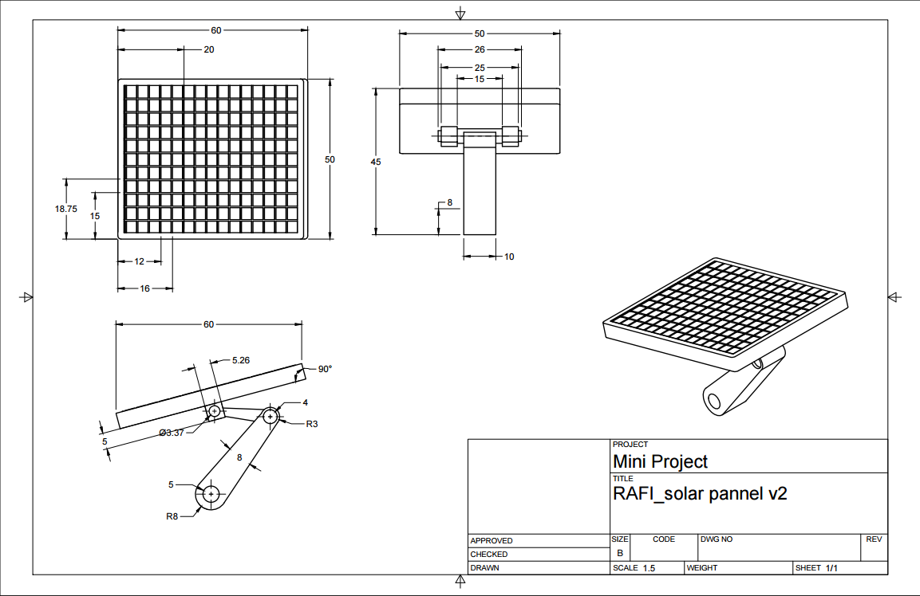
Solar pannel :- It converts sunlight into usable electricity .

Slide 22
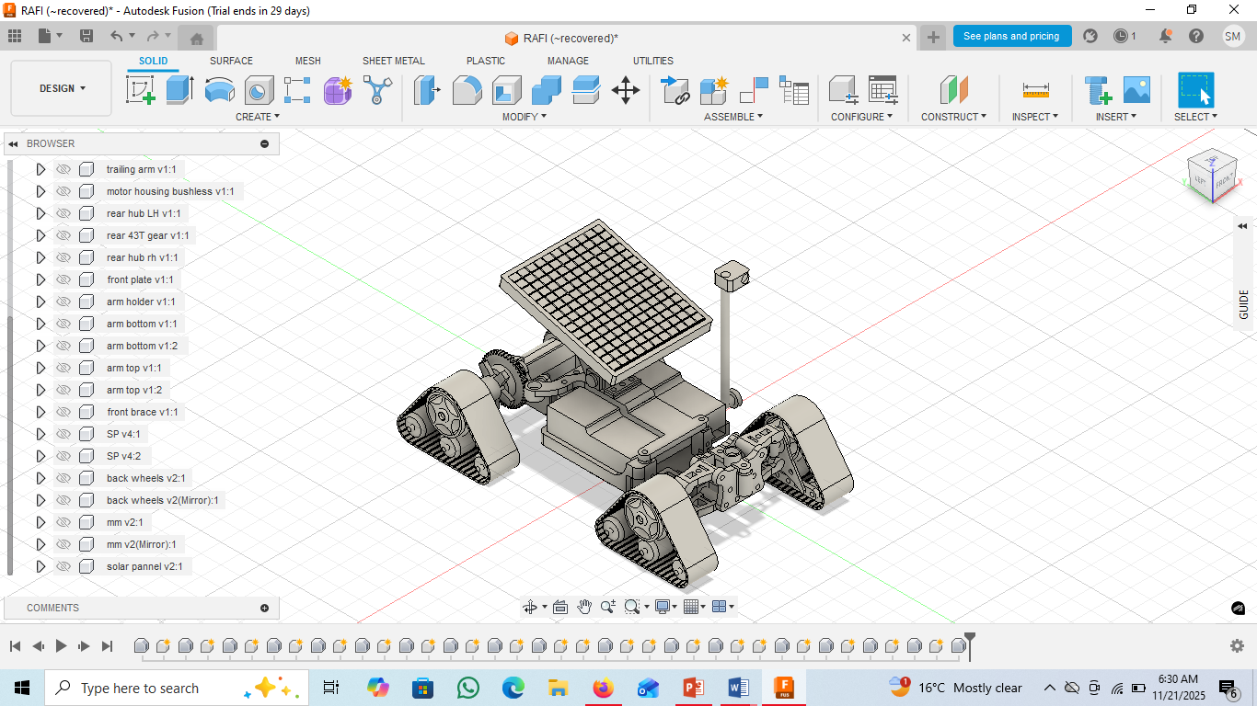

Slide 23
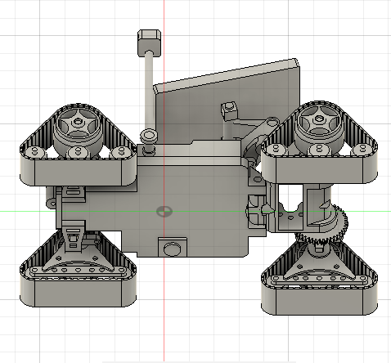
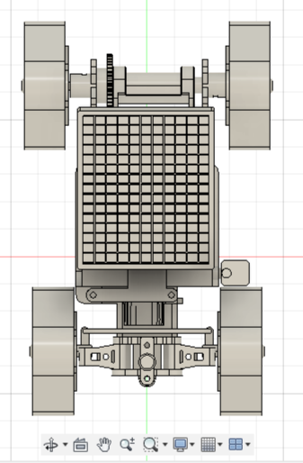
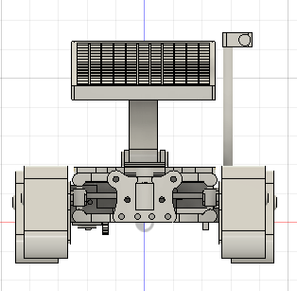
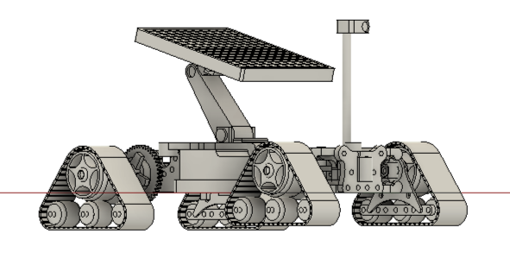

Slide 24
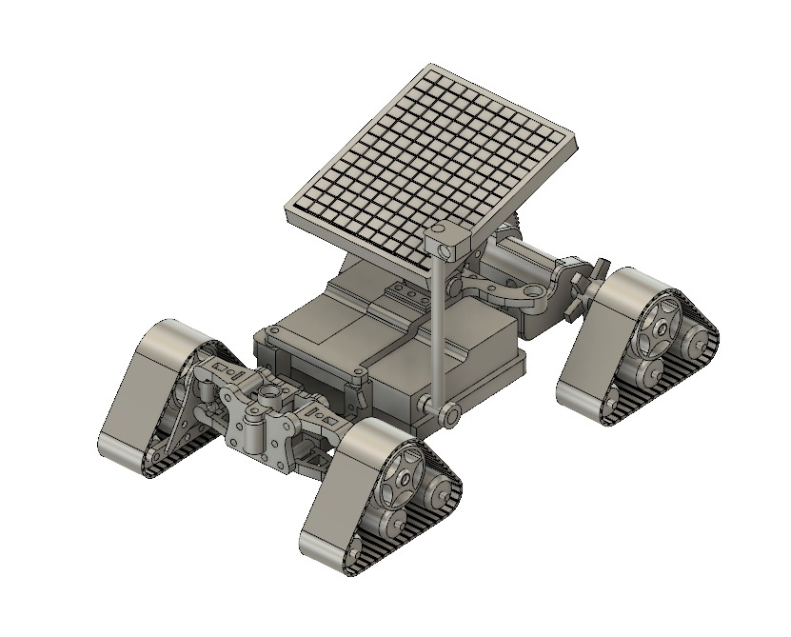

Slide 25
Methodology
Robot Captures Image
Image Pre processing
Plant Detection / ROI Extraction Disease
Segmentation
Severity Analysis
Generate Suggestions
Display output to user
End

Slide 26
Working:-
Robot captures images:-The robot (conceptually) moves in the field and takes pictures of the plants.
Image preprocessing:-The captured images are cleaned and enhanced to remove noise and improve clarity.
Plant detection /ROI extraction:-The system identifies the plant area and separates it from the background.
Segmentation:-The leaf or affected region is segmented to isolate the disease-suspected part.
Severity analysis:-The system checks how much of the leaf is affected and measures the disease severity.
Generate suggestions:-Based on analysis, the system prepares basic recommendations (e.g., disease type, severity level, next steps).
Display output to user:-The final result is shown to the farmer/user in a simple understandable format.
End:-Process completes and waits for the next image

Slide 27
Future Scope :-
Add Pesticide Spraying Module The robot can spray pesticides only on infected plants instead of the whole field. This reduces chemical usage, saves cost, and protects the environment.
Add Soil-Nutrient Sensors
Sensors like pH, moisture, and nitrogen detectors can provide information about
soil Health. Helps farmers manage irrigation and fertilizer more accurately.
Smart Path Planning
Robot can map the field and create the best route to cover all plants
with minimum time and energy.

Slide 28
Results :-
A complete 3D CAD model of the farmer assistant robot was created
All parts like chassis, wheels, and body were designed and assembled
Clear render images were produced to show how the robot looks.
A simple workflow for early disease detection was explained using images.
The model is stable, easy to build, and suitable for future sensor addition.

Slide 29
Conclusions:-
The project successfully designed a robot model in CAD software.
The model can be used in the future for early disease detection in farms.
It shows how a robot can help farmers by reducing manual work.
The design is simple, practical, and can be improved further with real hardware

Slide 30
References:-
1. Kamilaris, A., & Prenafeta-Boldú, F. X. (2018). Deep learning in agriculture: A survey.Computers and Electronics in Agriculture, 147, 70–90.
2. Vedantham, A. "Cloud and IoT Technologies Revolutionizing Precision Agriculture." Int. J. Sci. Res. Comput. Sci. Eng. Inf. Technol 10 (2024): 860-867.
3. Ferentinos, K. P. (2018). Deep learning models for plant disease detection and diagnosis. Computers and Electronics in Agriculture, 145, 311–318.
4. Zhang, C., & Kovacs, J. M. (2019). Precision agriculture using drone-based hyperspectral imaging. Remote Sensing, 11(5), 567.
5. Arnal Barbedo, J. G. (2016). A review on the use of unmanned aerial vehicles and imaging sensors for monitoring and assessing plant stresses. Drones, 1(2), 6.
6. Wäldchen, J., Rzanny, M., Seeland, M., & Mäder, P. (2018). Automated plant species identification—Trends and future directions. PLOS Computational Biology, 14(4), e1005993.

